Slide 1

Data

Slide 2
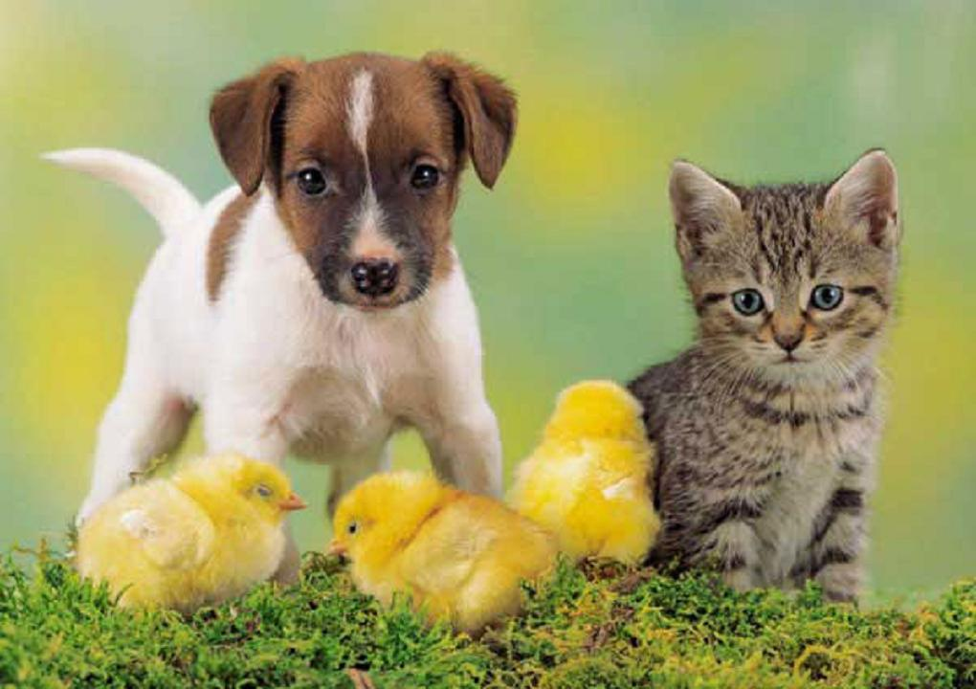


Types of data - There are many!
DATA
Tabular data
Image data
Textual data
Speech data
X1 | X2 | X3 | Y
1 | 3 | 0 | 1
2 | 1 | 1 | 0
.. | .. | .. | 1
Hello world! I’m glad that you made me feel bad.
…

Slide 3
CNN - Convolutional Neural Network
Layers:
Convolution - g(x).f(x)
Pooling - Max or Avg pooling
Flattening
Fully Connected Layer - Dense Layers

Slide 4
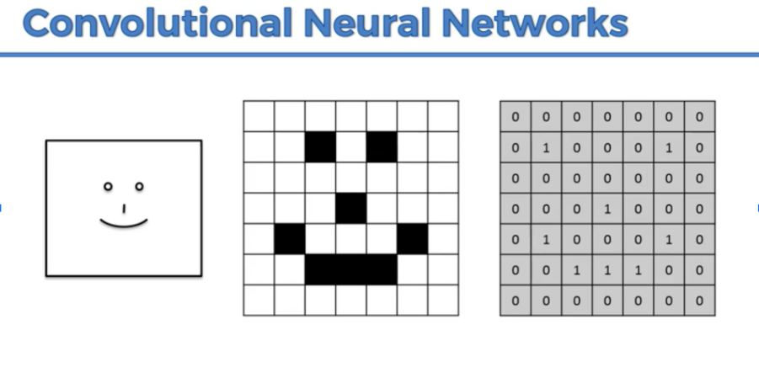

Slide 5
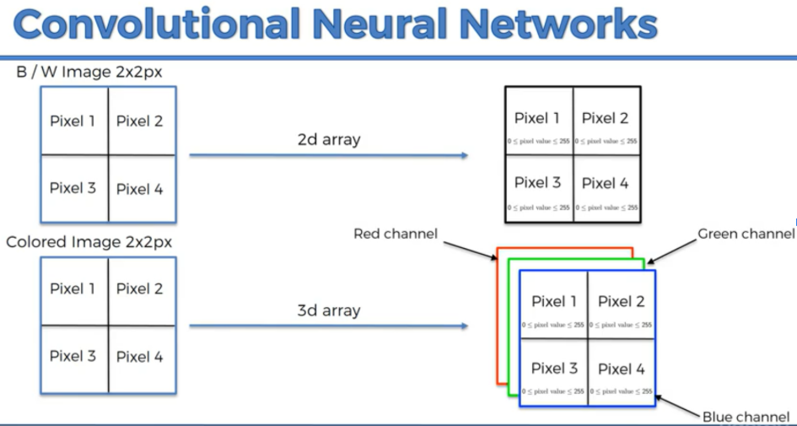

Slide 6
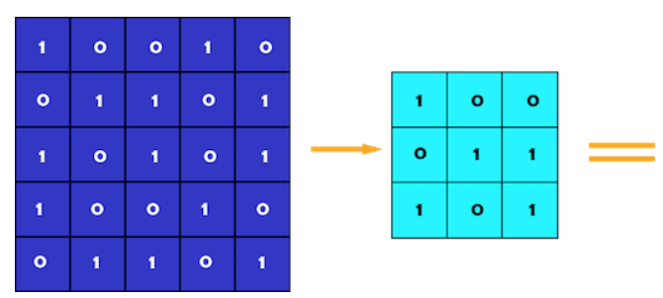
CNN - Convolutional Layer
Convolution Layer

Slide 7
CNN - Convolutional Layer
Step 1:
5

Slide 8
CNN - Convolutional Layer
Convolution Layer
5 | 1

Slide 9
CNN - Convolutional Layer
Convolution Layer
5 | 1 | 3

Slide 10
CNN - Convolutional Layer
Convolution Layer
Can you fill the remaining?
5 | 1 | 3
2

Slide 11
CNN - Convolutional Layer
Convolution Layer
5 | 1 | 3
2 | 3 | 2
2 | 2 | 4

Slide 12
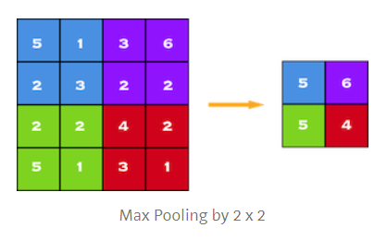
CNN - Pooling Layer
Step 2:

Slide 13
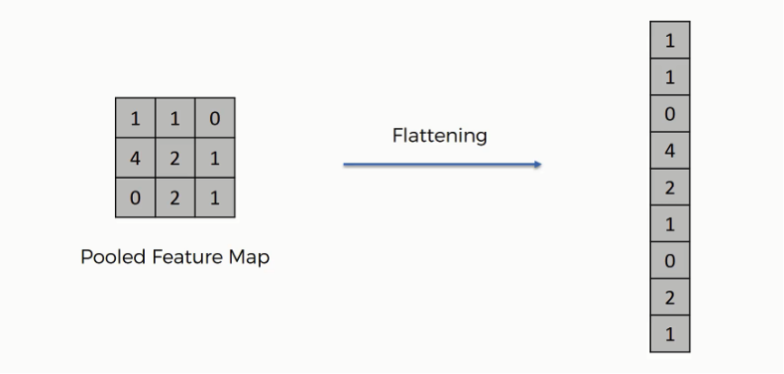
CNN - Flattening Layer
Step 3:

Slide 14
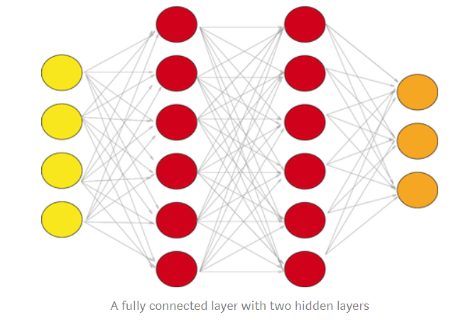

CNN - Fully Connected Layer
Step 4:
Softmax Output

Slide 15
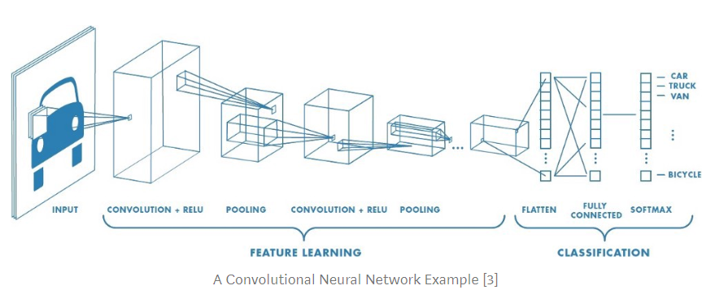
CNN - Convolutional Layer

Slide 16

It’s Coding Time!

Slide 17
Thank You!

Slide 18
Text Analytics

Slide 19
Textual data
Hello world! I’m glad that you made me feel bad. | Can you identify the semantic?
Placement is a process of assigning a specific job to each of the selected candidates. It implies matching the requirements of a job with the qualifications of the candidate. | What is it talking about and can you classify?

Slide 20
Tasks
Text Classification
Text Summarization
Text Generation
NLP
NLU + NLG

Slide 21
What are we trying to do?
Extract information from textual data.
Create insights

Slide 22
Text Classification
Data Cleaning
Create vectors for textual data
Visualising the embeddings
Implement a classification model
Train and validate the model
Insights

Slide 23
Thank You!

